Slide 1




CORONA VIRUS ANALYSIS
Mentorness Data Analytics Internship
Emmanuella Onos-Elenbalu

Slide 2


Contents
Overview | 3
Dataset Description | 4
Approach | 5
Analysis | 7
Insights | 16

Slide 3

Overview
 | The Corona Virus pandemic had a significant impact on public health and created an urgent need for data-driven insights to understand the spread of the virus. This project analysis 78,000+ records of corona virus entries between 2020 and 2021

Slide 4


The dataset is made up of 8 fields;
Province: The geographic subdivision within a country.
Country: The geographic entity where the data is recorded
Latitude: North-South position on the Earth's surface.
Longitude: East-West position on the Earth's surface
Date: In mmm-ddd-yyy format.
Confirmed: Number of diagnosed corona virus cases.
Death: Number of corona virus related deaths.
Recovered: Number of recovered corona virus cases.
Dataset Description
Emmanuella Onos-Elenbalu

Slide 5

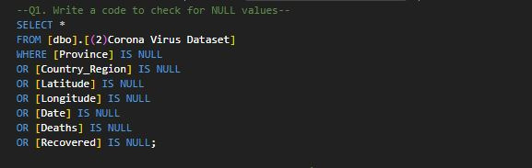
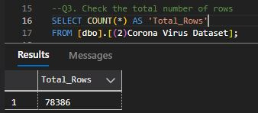
Approach
After the data was imported, the first step was to check for NULL values
No NULL values was found.
Next, I checked the row numbers.

Slide 6
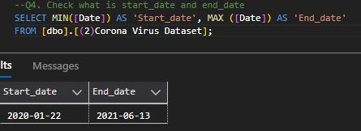
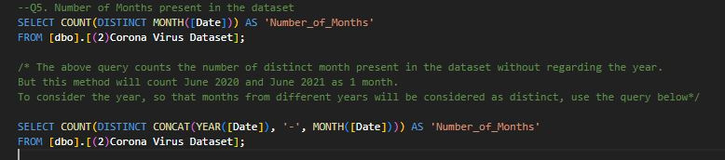
Confirmed the start and end date
Check the number of months

Slide 7
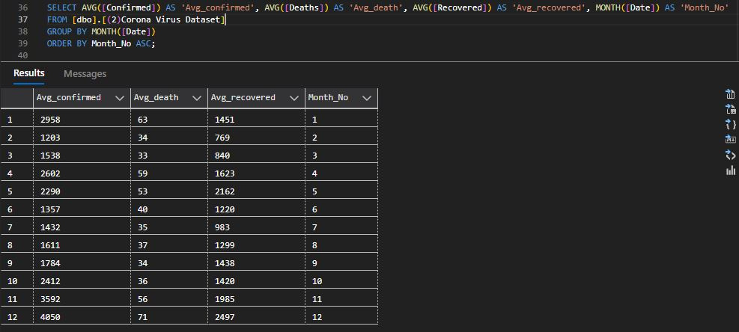
Analysis
Emmanuella Onos-Eelnbalu
The monthly average for confirmed, death, and recovered cases.

Slide 8
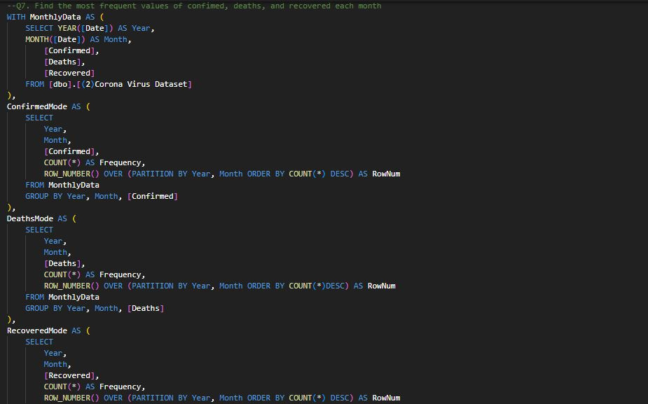
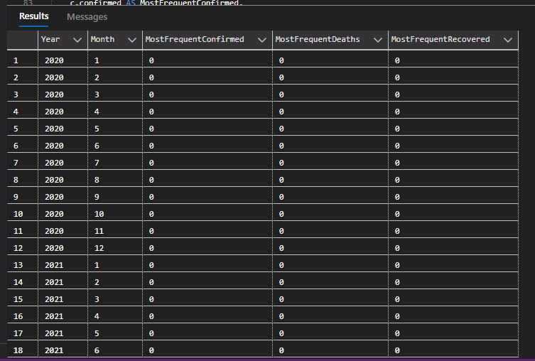
Most frequent value for confirmed, death, and recovered cases each month

Slide 9
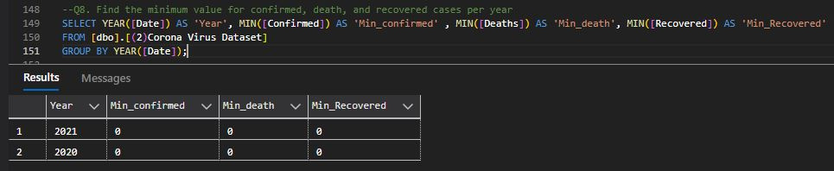
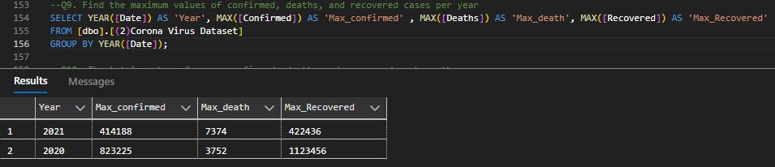
Minimum values for confirmed, death, and recovered per year
Maximum values for confirmed, death, and recovered per year

Slide 10
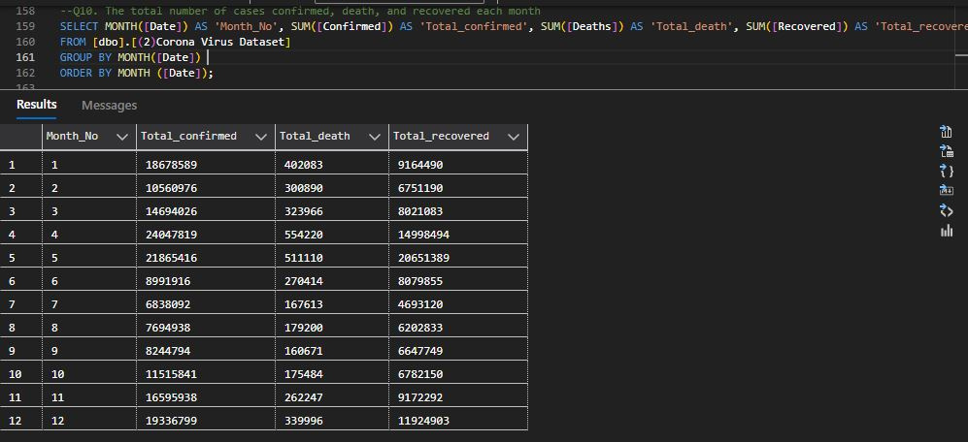
Total number of confirmed, death, and recovered cases per month

Slide 11
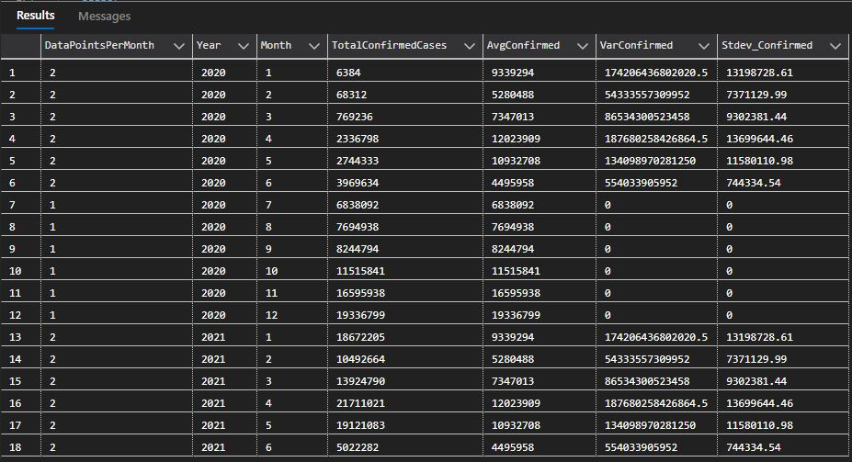
The spread of the virus in respect to confirmed cases
Emmanuella Onos-Elenbalu

Slide 12
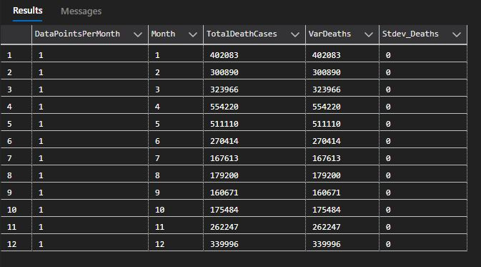
The spread of the virus in respect to death cases per month
Emmanuella Onos-Elenbalu

Slide 13
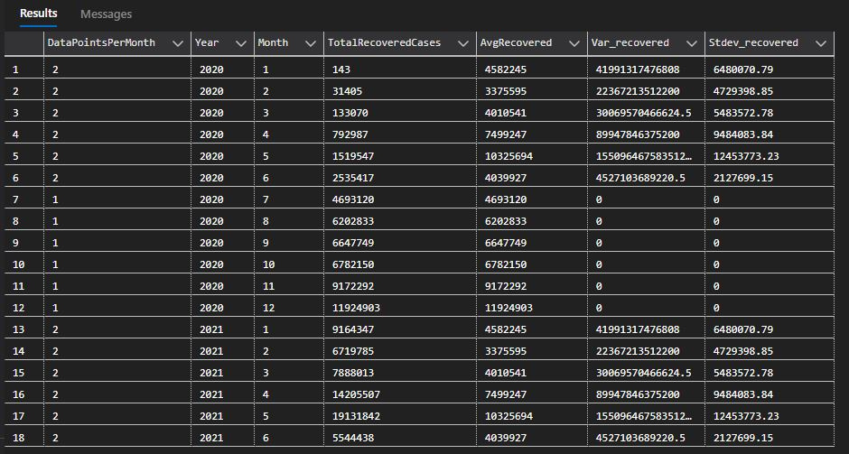
The spread of the virus in respect to recovered cases
Emmanuella Onos-Elenbalu

Slide 14
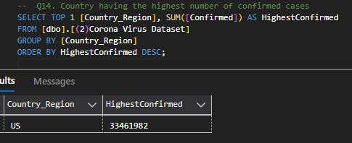
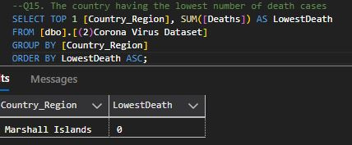
The country having the highest number of confirmed cases
The country having the lowest number of death cases
Emmanuella Onos-Elenbalu

Slide 15
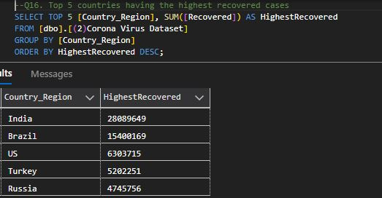
Top 5 countries with the highest recovered cases
Emmanuella Onos-Elenbalu

Slide 16
The U.S had the highest number of confirmed cases and the top 3 recovered cases
The Marshall Islands had the lowest number of death cases.
The total number of recovered cases per month was significantly higher than the total number of death cases.
The highest number of confirmed, death, and recovered cases peaked in April.
2020 had the highest number of confirmed and recovered cases while 2021 had the highest number of death cases.
Zero (0) is the most frequent value entered each month for confirmed, death, and recovered cases.
Insights
Emmanuella Onos-Elenbalu

